Slide 1

CSCE 222 Discrete Structures
Discrete Probability
Dr. Tim McGuire
Grateful acknowledgement to Professor Bart Selman, Cornell University, and Prof. Johnnie Baker, Kent State, for some of the material upon which these notes are adapted.
Notes:
Roger Creager - Sweet Home College Station, https://www.youtube.com/watch?v=K5Y1GmvAed0
Start 5 minutes before classhttps://www.youtube.com/watch?v=K5Y1GmvAed0

Slide 2
Based on Chapter 7 of Rosen Discrete Mathematics and its Applications

Slide 3
Now it’s time to look at…
Discrete Probability

Slide 4
Discrete Probability
Everything you have learned about counting constitutes the basis for computing the probability of events to happen.
In the following, we will use the notion experiment for a procedure that yields one of a given set of possible outcomes.
This set of possible outcomes is called the sample space of the experiment.
An event is a subset of the sample space.

Slide 5
Discrete Probability
If all outcomes in the sample space are equally likely, the following definition of probability applies:
The probability of an event E, which is a subset of a finite sample space S of equally likely outcomes, is given by p(E) = |E|/|S|.
Probability values range from 0 (for an event that will never happen) to 1 (for an event that will always happen whenever the experiment is carried out).

Slide 6
Discrete Probability
Example I:
An urn contains four blue balls and five red balls. What is the probability that a ball chosen from the urn is blue?
Solution:
There are nine possible outcomes, and the event “blue ball is chosen” comprises four of these outcomes. Therefore, the probability of this event is 4/9 or approximately 44.44%.

Slide 7
Discrete Probability
Example II:
What is the probability of winning the lottery 6/49, that is, picking the correct set of six numbers out of 49?
Solution:
There are C(49, 6) possible outcomes. Only one of these outcomes will actually make us win the lottery.
p(E) = 1/C(49, 6) = 1/13,983,816

Slide 8
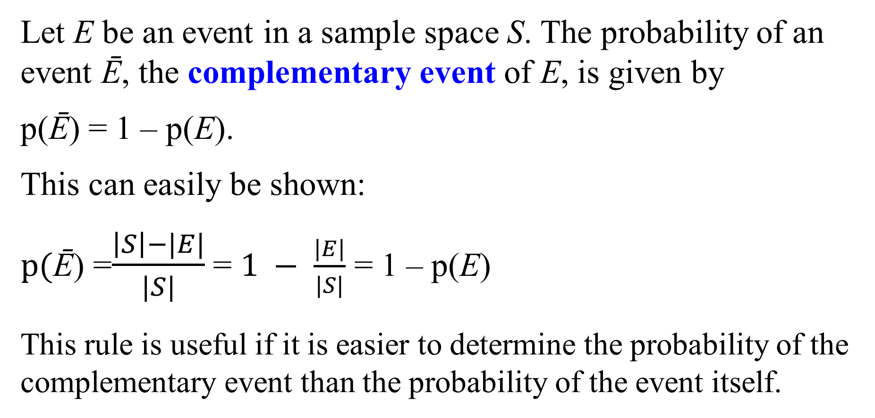
Complementary Events
Let E be an event in a sample space S. The probability of an event Ē, the complementary event of E, is given by
p(Ē) = 1 – p(E).
This can easily be shown:
$p(\text{Ē}\text{)}$ =$\frac{\left|S\right|−|E|}{|S|}$ = $1 − \frac{|E|}{|S|}$ = 1 – p(E)
This rule is useful if it is easier to determine the probability of the complementary event than the probability of the event itself.

Slide 9
Complementary Events
Example I: A sequence of 10 bits is randomly generated. What is the probability that at least one of these bits is zero?
Solution: There are 2¹⁰ = 1024 possible outcomes of generating such a sequence. The event –E, “none of the bits is zero”, includes only one of these outcomes, namely the sequence 1111111111.
Therefore, p(Ē) = 1/1024.
Now p(E) can easily be computed as p(E) = 1 – p(Ē) = 1 – 1/1024 = 1023/1024.

Slide 10
Complementary Events
Example II: What is the probability that at least two out of 36 people have the same birthday?
Solution: The sample space S encompasses all possibilities for the birthdays of the 36 people, so |S| = 365³⁶.
Let us consider the event Ē (“no two people out of 36 have the same birthday”). Ē includes P(365, 36) outcomes (365 possibilities for the first person’s birthday, 364 for the second, and so on).
Then p(Ē) = P(365, 36)/365³⁶ = 0.168, so p(E) = 0.832 or 83.2%

Slide 11
Discrete Probability
Let E₁ and E₂ be events in the sample space S. Then we have:
p(E₁ ∪ E₂) = p(E₁) + p(E₂) – p(E₁ ∩ E₂)
Does this remind you of something?
Of course, the principle of inclusion-exclusion.
|A ∪ B| = |A| + |B| - |A ∩ B|

Slide 12
Discrete Probability
Example: What is the probability of a positive integer selected at random from the set of positive integers not exceeding 100 to be divisible by 2 or 5?
Solution:
E₂: “integer is divisible by 2” E₅: “integer is divisible by 5”
E₂ = {2, 4, 6, …, 100}
|E₂| = 50
p(E₂) = 0.5

Slide 13
Discrete Probability
E₅ = {5, 10, 15, …, 100}
|E₅| = 20
p(E₅) = 0.2
E₂ ∩ E₅ = {10, 20, 30, …, 100}
|E₂ ∩ E₅| = 10
p(E₂ ∩ E₅) = 0.1
p(E₂ ∪ E₅) = p(E₂) + p(E₅) – p(E₂ ∩ E₅ )
p(E₂ ∪ E₅) = 0.5 + 0.2 – 0.1 = 0.6

Slide 14
Discrete Probability
What happens if the outcomes of an experiment are not equally likely?
In that case, we assign a probability p(s) to each outcome s∈S, where S is the sample space.
Two conditions have to be met:
(1): 0 ≤ p(s) ≤ 1 for each s∈S, and
(2): ∑_{s∈S} p(s) = 1
This means, as we already know, that (1) each probability must be a value between 0 and 1, and (2) the probabilities must add up to 1, because one of the outcomes is guaranteed to occur.

Slide 15
Discrete Probability
How can we obtain these probabilities p(s) ?
The probability p(s) assigned to an outcome s equals the limit of the number of times s occurs divided by the number of times the experiment is performed.
Once we know the probabilities p(s), we can compute the probability of an event E as follows:
p(E) = ∑_{s∈E} p(s)

Slide 16
Discrete Probability
Example I: A die is biased so that the number 3 appears twice as often as each other number.
What are the probabilities of all possible outcomes?
Solution: There are 6 possible outcomes s₁, …, s₆.
p(s₁) = p(s₂) = p(s₄) = p(s₅) = p(s₆)
p(s₃) = 2p(s₁)
Since the probabilities must add up to 1, we have:
5p(s₁) + p(s₃) = 5p(s₁) + 2p(s₁) =1
7p(s₁) = 1 → p(s₁) = 1/7 p(s₁) = p(s₂) = p(s₄) = p(s₅) = p(s₆) = 1/7, p(s₃) = 2/7

Slide 17
Discrete Probability
Example II: For the biased die from Example I, what is the probability that an odd number appears when we roll the die?
Solution:
E_{odd} = {s₁, s₃, s₅}
Remember the formula p(E) = ∑_{s∈E} p(s).
p(E_{odd}) = ∑_{s∈Eodd} p(s) = p(s₁) + p(s₃) + p(s₅)
p(E_{odd}) = 1/7 + 2/7 + 1/7 = 4/7 = 57.14%

Slide 18
Conditional Probability
If we toss a coin three times, what is the probability that an odd number of tails appears (event E), if the first toss is a tail (event F) ?
If the first toss is a tail, the possible sequences are TTT, TTH, THT, and THH.
In two out of these four cases, there is an odd number of tails.
Therefore, the probability of E, under the condition that F occurs, is 0.5.
We call this conditional probability.

Slide 19
Conditional Probability
If we want to compute the conditional probability of E given F, we use F as the sample space.
For any outcome of E to occur under the condition that F also occurs, this outcome must also be in E ∩ F.
Definition: Let E and F be events with p(F) > 0. The conditional probability of E given F, denoted by p(E | F), is defined as
p(E | F) = p(E ∩ F)/p(F)

Slide 20
Conditional Probability
Example: What is the probability of a random bit string of length four to contain at least two consecutive 0s, given that its first bit is a 0 ?
Solution:
E: “bit string contains at least two consecutive 0s”
F: “first bit of the string is a 0”
We know the formula p(E | F) = p(E ∩ F)/p(F).
E ∩ F = {0000, 0001, 0010, 0011, 0100}
p(E ∩ F) = 5/16
p(F) = 8/16 = 1/2
p(E | F) = (5/16)/(1/2) = 10/16 = 5/8 = 0.625

Slide 21
Independence
Let us return to the example of tossing a coin three times.
Does the probability of event E (odd number of tails) depend on the occurrence of event F (first toss is a tail) ?
In other words, is it the case that p(E | F) ≠ p(E) ?
We actually find that p(E | F) = 0.5 and p(E) = 0.5, so we say that E and F are independent events.

Slide 22
Independence
Because we have p(E | F) = p(E ∩ F)/p(F), p(E | F) = p(E) if and only if p(E ∩ F) = p(E)p(F).
Definition: The events E and F are said to be independent if and only if p(E ∩ F) = p(E)p(F).
Obviously, this definition is symmetrical for E and F. If we have p(E ∩ F) = p(E)p(F), then it is also true that p(F | E) = p(F).

Slide 23
Independence
Example: Suppose E is the event of rolling an even number with an unbiased die. F is the event that the resulting number is divisible by three. Are events E and F independent?
Solution:
p(E) = 1/2, p(F) = 1/3.
|E ∩ F|= 1 (only 6 is divisible by both 2 and 3)
p(E ∩ F) = 1/6
p(E ∩ F) = p(E)p(F)
Conclusion: E and F are independent.

Slide 24
Bernoulli Trials
Suppose an experiment with two possible outcomes, such as tossing a coin.
Each performance of such an experiment is called a Bernoulli trial.
We will call the two possible outcomes a success or a failure, respectively. The probabilities of the two outcomes could be different.
If p is the probability of a success and q is the probability of a failure, it is obvious that p + q = 1.

Slide 25
Bernoulli Trials
Often we are interested in the probability of exactly k successes when an experiment consists of n independent Bernoulli trials.
Example: A coin is biased so that the probability of head is 2/3. What is the probability of exactly four heads to come up when the coin is tossed seven times?

Slide 26
Bernoulli Trials
Solution:
There are 2⁷ = 128 possible outcomes.
The number of possibilities for four heads among the seven trials is C(7, 4).
The seven trials are independent, so the probability of each of these outcomes is (2/3)⁴(1/3)³.
Consequently, the probability of exactly four heads to appear is
C(7, 4)(2/3)⁴(1/3)³ = 560/2187 = 25.61%

Slide 27
Bernoulli Trials
A coin is tossed 8 times. What is the probability of exactly 3 heads in the 8 tosses?
THHTTHTT is a tossing sequence…
How many ways of choosing 3 positions for the heads?
C(8,3)
What is the probability of a particular sequence?
.5⁸
In general: The probability of exactly k successes in n independent Bernoulli trials with probability of success p, is
C(n,k)p^{k}(1-p)^{n-k}

Slide 28
Bernoulli Trials and Binomial Distribution
Bernoulli Formula: Consider an experiment which repeats a Bernoulli trial n times. Suppose each Bernoulli trial has possible outcomes A, B with respective probabilities p and 1-p. The probability that A occurs exactly k times in n trials is
C (n,k ) p ^{k} · (1-p)^{n-k}
Binomial Distribution: denoted by b(k;n;p) – this function gives the probability of k successes in n independent Bernoulli trials with probability of success p and probability of failure q = 1- p
b(k;n;p)= C (n,k ) p ^{k} · (1-p)^{n-k}

Slide 29
Bernoulli Trials
Consider flipping a fair coin n times.
A = coin comes up “heads”
B = coin comes up “tails”
p = 1-p = ½
Q: What is the probability of getting exactly 10 heads if you flip a coin 20 times?
Recall: P (A occurs k times out of n)
= C (n,k ) p ^{k} · (1-p)^{n-k}

Slide 30
Bernoulli Trials: flipping fair coin
A: (1/2)¹⁰ · (1/2)¹⁰ ·C (20,10)
= 184756 / 2²⁰
= 184756 / 1048576
= 0.1762…
Consider flipping a coin n times.
What is the most likely number of
heads occurrence?
n/2
What probability?
C(n, n/2) . (1/2)^{n}
What is the least likely number?
0 or n
What probability?
(1/2)^{n} (e.g. for n = 100 … it’s “never”)

Slide 31
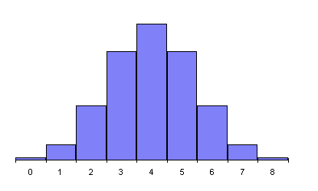
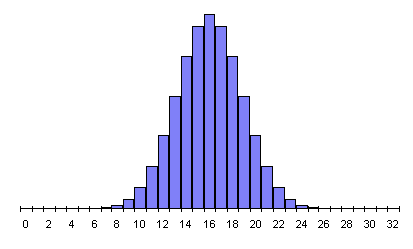
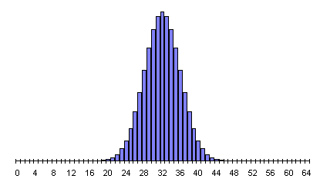
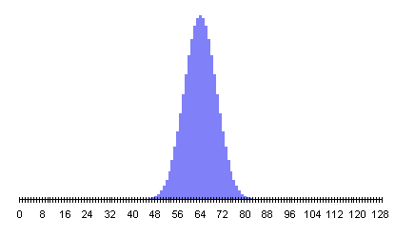
Histogram for tossing a coin n times and counting the number of heads

Slide 32
Suppose a 0 bit is generated with probability 0.9 and a 1 bit is generated with probability 0.1., and that bits are generated independently. What is the probability that exactly eight 0 bits out of ten bits are generated?
b(8;10;0.9)= C(10,8)(0.9)⁸(0.1)² = 0.1937102445

Slide 33
Bernoulli Trials
A game of Candy Crush is played 5 times. You clear the board 70% of the time. What is the probability that you win a majority of the 5 games?
Sanity check: What is the probability the result is WWLLW?
.7³.3²
Assumes independent trials
In general: The probability of exactly k successes in n independent Bernoulli trials with probability of success p, is
C(n,k)p^{k}(1-p)^{n-k}
C(5,3)0.7³0.3² + C(5,4)0.7⁴0.3¹ + C(5,5)0.7⁵0.3⁰

Slide 34
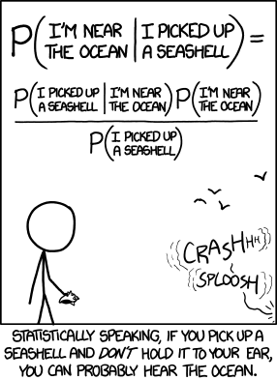

Slide 35
Bernoulli Trials
Illustration: Let us denote a success by ‘S’ and a failure by ‘F’. As before, we have a probability of success p and probability of failure q = 1 – p.
What is the probability of two successes in five independent Bernoulli trials?
Let us look at a possible sequence:
SSFFF
What is the probability that we will generate exactly this sequence?

Slide 36
Bernoulli Trials
Sequence:
Probability:
S
S
F
F
F
p
p
q
q
q
= p²q³
Another possible sequence:
Sequence:
Probability:
F
S
F
S
F
q
p
q
p
q
= p²q³
Each sequence with two successes in five trials occurs with probability p²q³.

Slide 37
Bernoulli Trials
And how many possible sequences are there?
In other words, how many ways are there to pick two items from a list of five?
We know that there are C(5, 2) = 10 ways to do this, so there are 10 possible sequences, each of which occurs with a probability of p²q³.
Therefore, the probability of any such sequence to occur when performing five Bernoulli trials is C(5, 2) p²q³.
In general, for k successes in n Bernoulli trials we have a probability of C(n,k)p^{k}q^{n-k}.

Slide 38
Random Variables
Example:
Let X be the result of a rock-paper-scissors game.
If player A chooses symbol a and player B chooses symbol b, then
X(a, b) = 1, if player A wins,
= 0, if A and B choose the same symbol,
= -1, if player B wins.

Slide 39
Random Variables
X(rock, rock) =
0
X(rock, paper) =
-1
X(rock, scissors) =
1
X(paper, rock) =
1
X(paper, paper) =
0
X(paper, scissors) =
-1
X(scissors, rock) =
-1
X(scissors, paper) =
1
X(scissors, scissors) =
0

Slide 40
Expected Values
Once we have defined a random variable for our experiment, we can statistically analyze the outcomes of the experiment.
For example, we can ask: What is the average value (called the expected value) of a random variable when the experiment is carried out a large number of times?
Can we just calculate the arithmetic mean across all possible values of the random variable?

Slide 41
Expected Values
No, we cannot, since it is possible that some outcomes are more likely than others.
For example, assume the possible outcomes of an experiment are 1 and 2 with probabilities of 0.1 and 0.9, respectively.
Is the average value 1.5?
No, since 2 is much more likely to occur than 1, the average must be larger than 1.5.

Slide 42
Expected Values
Instead, we have to calculate the weighted sum of all possible outcomes, that is, each value of the random variable has to be multiplied with its probability before being added to the sum.
In our example, the average value is given by 0.1⋅1 + 0.9⋅2 = 0.1 + 1.8 = 1.9.
Definition: The expected value (or expectation) of the random variable X(s) on the sample space S is equal to:
E(X) = ∑_{s∈S}p(s)X(s).

Slide 43
Expected Values
Example: Let X be the random variable equal to the sum of the numbers that appear when a pair of dice is rolled.
There are 36 outcomes (= pairs of numbers from 1 to 6).
The range of X is {2, 3, 4, 5, 6, 7, 8, 9, 10, 11, 12}.
Are the 36 outcomes equally likely?
Yes, if the dice are not biased.
Are the 11 values of X equally likely to occur?
No, the probabilities vary across values.

Slide 44
Expected Values
P(X = 2) =
1/36
P(X = 3) =
2/36 = 1/18
P(X = 4) =
3/36 = 1/12
P(X = 5) =
4/36 = 1/9
P(X = 6) =
5/36
P(X = 7) =
6/36 = 1/6
P(X = 8) =
5/36
P(X = 9) =
4/36 = 1/9
P(X = 10) =
3/36 = 1/12
P(X = 11) =
2/36 = 1/18
P(X = 12) =
1/36

Slide 45
Expected Values
E(X) = 2⋅(1/36) + 3⋅(1/18) + 4⋅(1/12) + 5⋅(1/9) + 6⋅(5/36) + 7⋅(1/6) + 8⋅(5/36) + 9⋅(1/9) + 10⋅(1/12) + 11⋅(1/18) + 12⋅(1/36)
E(X) = 7
This means that if we roll the dice many times, sum all the numbers that appear and divide the sum by the number of trials, we expect to find a value of 7.

Slide 46
Expected Values
Theorem:
If X and Y are random variables on a sample space S, then E(X + Y) = E(X) + E(Y).
Furthermore, if X_{i}, i = 1, 2, …, n with a positive integer n, are random variables on S, then E(X₁ + X₂ + … + X_{n}) = E(X₁) + E(X₂) + … + E(X_{n}).
Moreover, if a and b are real numbers, then E(aX + b) = aE(X) + b.

Slide 47
Expected Values
Knowing this theorem, we could now solve the previous example much more easily:
Let X₁ and X₂ be the numbers appearing on the first and the second die, respectively.
For each die, there is an equal probability for each of the six numbers to appear. Therefore, E(X₁) = E(X₂) = (1 + 2 + 3 + 4 + 5 + 6)/6 = 7/2.
We now know that E(X₁ + X₂) = E(X₁) + E(X₂) = 7.

Slide 48
Expected Values
We can use our knowledge about expected values to compute the average-case complexity of an algorithm.
Let the sample space be the set of all possible inputs a₁, a₂, …, a_{n}, and the random variable X assign to each a_{j} the number of operations that the algorithm executes for that input.
For each input a_{j}, the probability that this input occurs is given by p(a_{j}).
The algorithm’s average-case complexity then is:
E(X) = ∑_{j=1,…,n}p(a_{j})X(a_{j})

Slide 49
Expected Values
However, in order to conduct such an average-case analysis, you would need to find out:
the number of steps that the algorithms takes for any (!) possible input, and
the probability for each of these inputs to occur.
For most algorithms, this would be a highly complex task, so we will stick with the worst-case analysis.

Slide 50
Optional Material past this point

Slide 51
Independent Random Variables
Definition: The random variables X and Y on a sample space S are independent if
p(X(s) = r₁ ∧ Y(s) = r₂) = p(X(s) = r₁) ⋅ p(Y(s) = r₂).
In other words, X and Y are independent if the probability that X(s) = r₁ ∧ Y(s) = r₂ equals the product of the probability that X(s) = r₁ and the probability that Y(s) = r₂ for all real numbers r₁ and r₂.

Slide 52
Independent Random Variables
Example: Are the random variables X₁ and X₂ from the “pair of dice” example independent?
Solution:
p(X₁ = i) = 1/6
p(X₂ = j) = 1/6
p(X₁ = i ∧ X₂ = j) = 1/36
Since p(X₁ = i ∧ X₂ = j) = p(X₁ = i)⋅p(X₂ = j) , the random variables X₁ and X₂ are independent.

Slide 53
Independent Random Variables
Theorem: If X and Y are independent random variables on a sample space S, then E(X∙Y) = E(X)∙E(Y).
Note:
E(X + Y) = E(X) + E(Y) is true for any X and Y, but
E(X∙Y) = E(X)∙E(Y) needs X and Y to be independent.

Slide 54
Independent Random Variables
Example: Let X and Y be random variables on some sample space, and each of them assumes the values 1 and 3 with equal probability.
Then E(X) = E(Y) = 2
If X and Y are independent, we have:
E(X + Y) = 1/4·(1 + 1) + 1/4·(1 + 3) + 1/4·(3 + 1) + 1/4·(3 + 3) = 4 = E(X) + E(Y)
E(X∙Y) = 1/4·(1·1) + 1/4·(1·3) + 1/4·(3·1) + 1/4·(3·3) = 4 = E(X)·E(Y)

Slide 55
Independent Random Variables
Let us now assume that X and Y are correlated in such a way that Y = 1 whenever X = 1, and Y = 3 whenever X = 3.
E(X + Y) = 1/2·(1 + 1) + 1/2·(3 + 3) = 4 = E(X) + E(Y)
E(X∙Y) = 1/2·(1·1) + 1/2·(3·3) = 5 ≠ E(X)·E(Y)

